Slide 1

Test Readiness Review
Notes:
Dylan
Welcome and thank you for coming to embry-riddle hydrogens design concept review. Our project focuses on hydrogen technology, specifically electrolysis and material storage of hydrogen

Slide 2







Team Members
Dylan Astrup
Detail Team Lead
Hannah Spiller
Lead Material Storage Engineer
Grant Carrabine
Lead Electrolysis Engineer
Tesla Alford III
Lead Extraction Engineer
Titan Berson
Lead Interface Engineer
Jacob Wolf
Lead Piping Engineer
Notes:
Dylan

Slide 3





Agenda
Background
Test Overviews
Risk & Safety
Timeline
Objectives
Notes:
Dylan

Slide 4
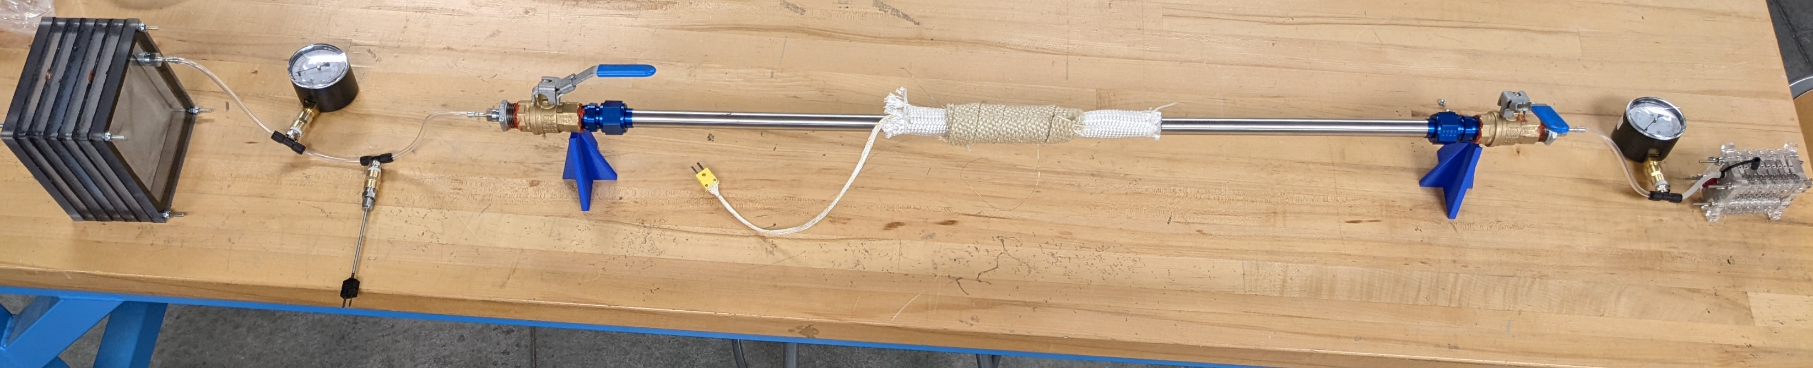
ERH2 Proposed System
Pressure Gauge
Electrolyzer
Valves
Fuel Cell
Stainless Steel Pipe
Storage & Extraction
Thermocouples
4
Notes:
Jacob
Include fuel cell

Slide 5
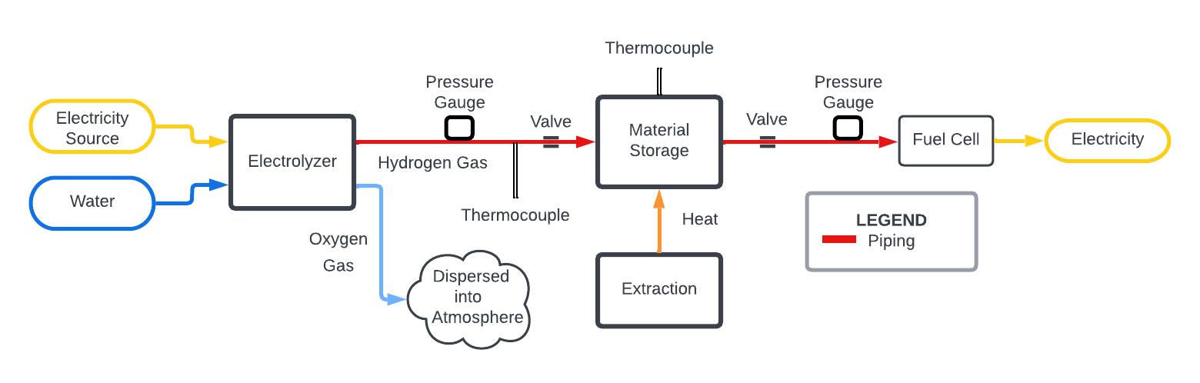
Process Flow Diagram
Simplified PFD
Notes:
Jacob
Highlight:

Slide 6
System Requirements
Produce Hydrogen
1.1.1 The system must produce enough hydrogen to get the fuel cell to steady state and then run for 10 minutes at 1 watt.
Store Hydrogen
1.2 The storage method must run the fuel cell for a minimum of 5 minutes.
1.2.1 The system must measure the amount of hydrogen stored.
1.1.2 The system must determine the rate of hydrogen gas produced.
Notes:
Hannah- don’t read all of this
Removed Content: Run Fuel Cell
1.4 The system must interface with the Embry-Riddle fuel cell.
1.4.1 The system output must be a ¼” PTFE tube.
Energy Demonstrator
1.3 The system must fit into a 45”x25” footprint.

Slide 7

Overview of Tests
1.
Leak Detection
2.
Heating Amperage
3.
Valve Temperature
4.
Insulation Temperature
5.
Hydrogen Production
6.
Material Storage Capacity
7.
Hydrogen Release
8.
Flow Storage

Slide 8
1. Leak Detection
Objective: Detect leaks in the system (req 1.1.1).
Facilities: Compressed air hose, soap, ERH2 system from the electrolysis to the fuel cell
Location: AXFAB
Success Criteria: No bubbles form.
Notes:
Titan
PROCEDURE: At all interfaces and valves, apply soap mixture covering the interface, and connect to the compressed air hose. Run the compressed air through the system and document where bubbles occur.

Slide 9
1. Leak Detection
Apply Soap Water
Notes:
Titan

Slide 10
2. Heating Amperage
Objective: Test the amperage of the nichrome wire (req 1.2).
Facilities: Power supply, nichrome wire, stainless pipe, thermocouple
Location: STEM 114
Success Criteria: The power supply heats the pipe to 300°C with less than 20 amps.
Notes:
Tesla
PROCEDURE: Connect the power supply to the nichrome wire heating zone. Supply wire with 0.80 amps and record the maximum temperature reached. If less than 300 C, repeat test increasing amperages by 0.1 amps until 300 C.

Slide 11
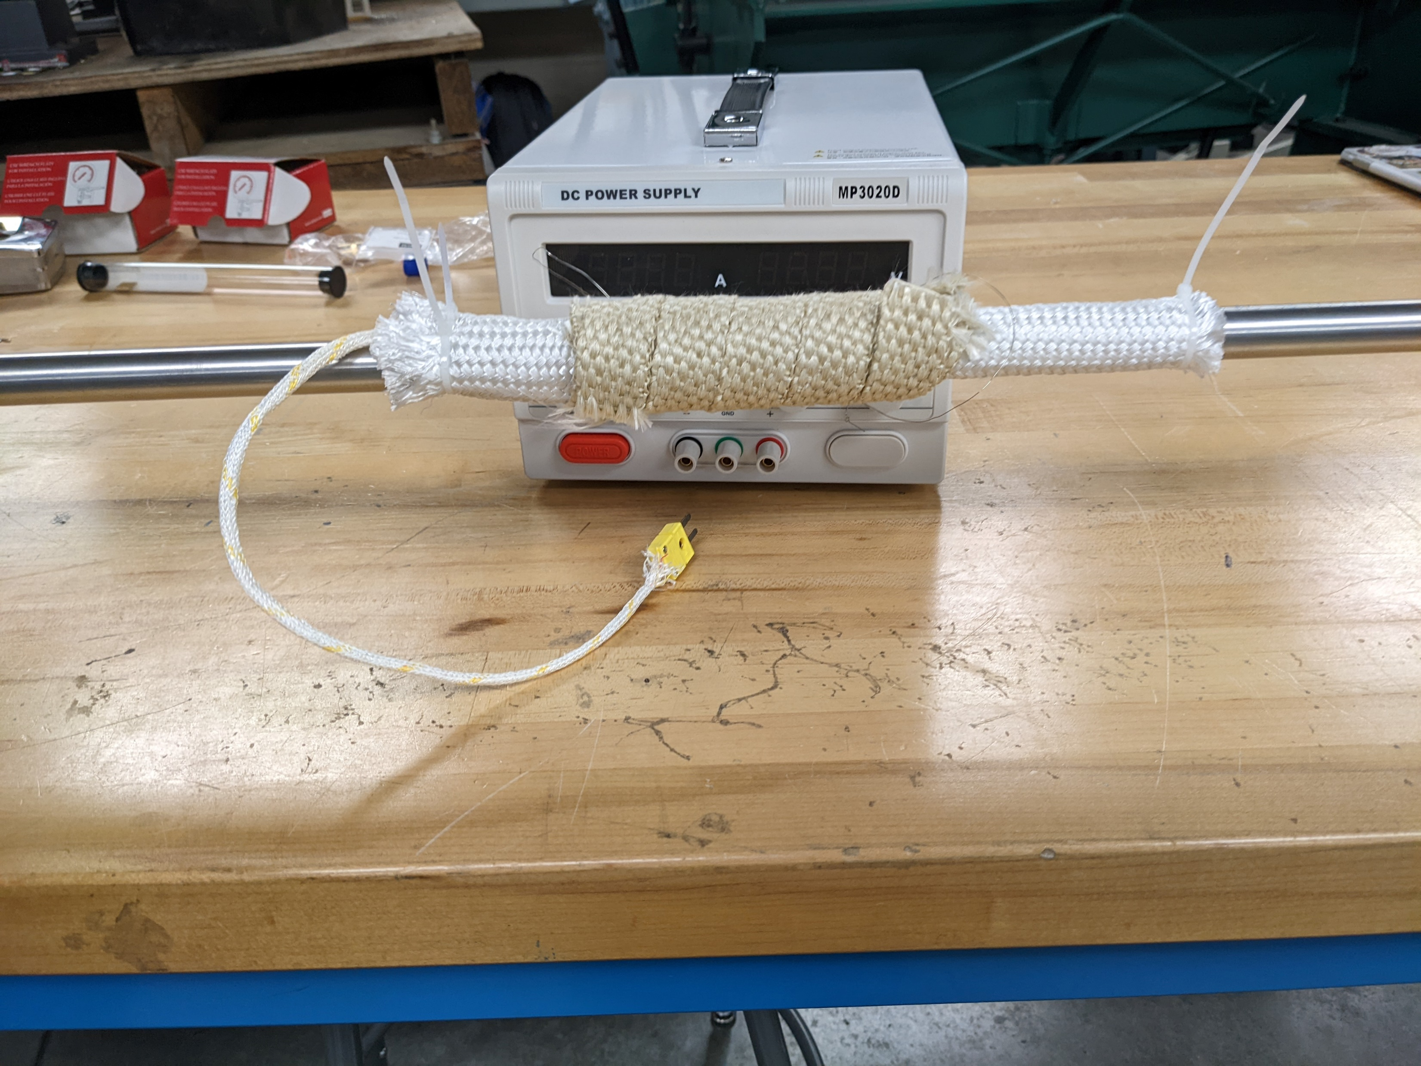
2. Heating Amperage
Thermocouple
Supply 0.8 amps to the heating zone and determine steady state temperature. Increase amperage by 0.1 amps until heating zone reaches 300°C.
Record maximum temperature of heating zone at varying amperages.
Notes:
Tesla

Slide 12
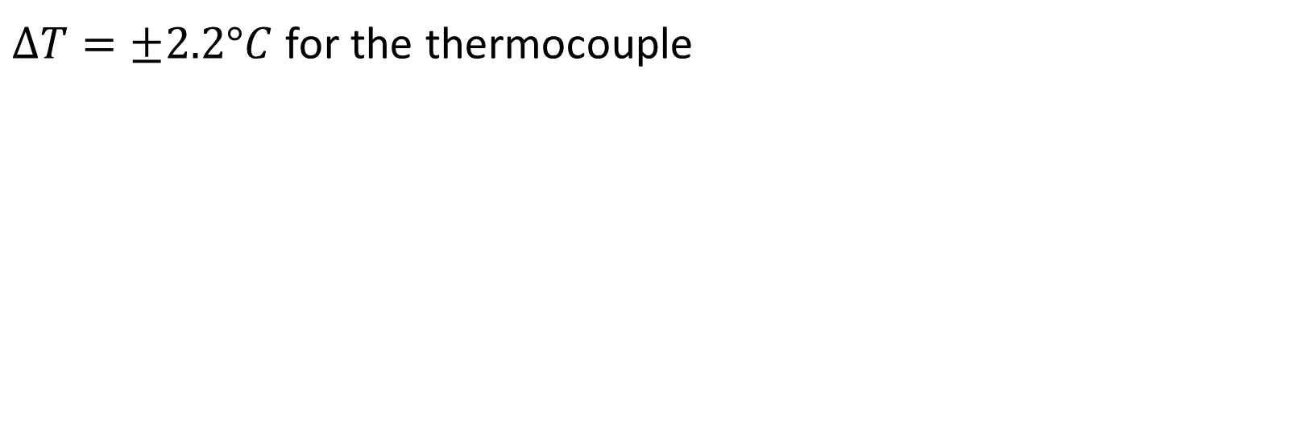
2. Heating Amperage - Uncertainty
$ΔT=±2.2°C$ for the thermocouple
Notes:
Tesla

Slide 13
3. Valve Temperature
Objective: Determine the temperature at the ends of the pipe (at the valves). (req 1.1.1)
Facilities: Heating system, pipe to hold capsule, 2 thermocouples
Location: STEM 114
Success Criteria: The test is successful if the ends of the pipe do not exceed 50°C.
Notes:
Jacob
PROCEDURE: Connect power supply to heating element and place a thermocouple in the heating zone and at the end of the pipe where the valve would be. Turn on the power supply and record the temperature of the heating zone and the end of the pipe over time. Stop test when the heating zone reaches 350 C.

Slide 14
3. Valve Temperature
Thermocouple
Thermal Imaging Camera
Turn on power supply to heating system and heat until 350°C.
Record temperature of ends and heating zone at steady state conditions.
Notes:
Jacob

Slide 15
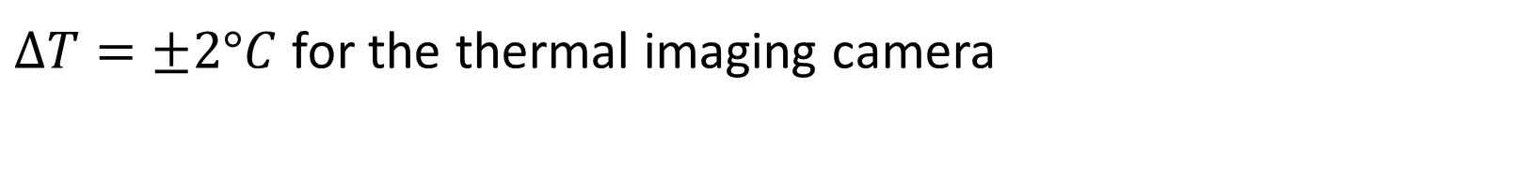
3. Valve Temperature - Uncertainty
$ΔT=±2°C$ for the thermal imaging camera
Notes:
Jacob

Slide 16
4. Insulation Temperature
Objective: Test temperature of insulation.
Facilities: Nichrome wire, Insulation tape, power supply, stainless steel pipe, thermocouple, thermal imaging camera
Location: Propulsion Lab
Success Criteria: The insulation temperature does not exceed 50°C.
Notes:
Tesla
PROCEDURE: Connect power supply to heating element and place a thermocouple in the heating zone and at the surface of the insulation. Turn on the power supply and record the temperature of the heating zone, the temperature of the surrounding air, and the insulation over time. Turn off power supply when the heating zone reaches 350 C.

Slide 17
4. Insulation Temperature
Thermal Imaging Camera
Thermocouple
Supply heating zone with amperage to get heating zone to 350°C and measure temperature of insulation.
Record temperature of heating zone and surface of insulation over time.
Notes:
Tesla

Slide 18
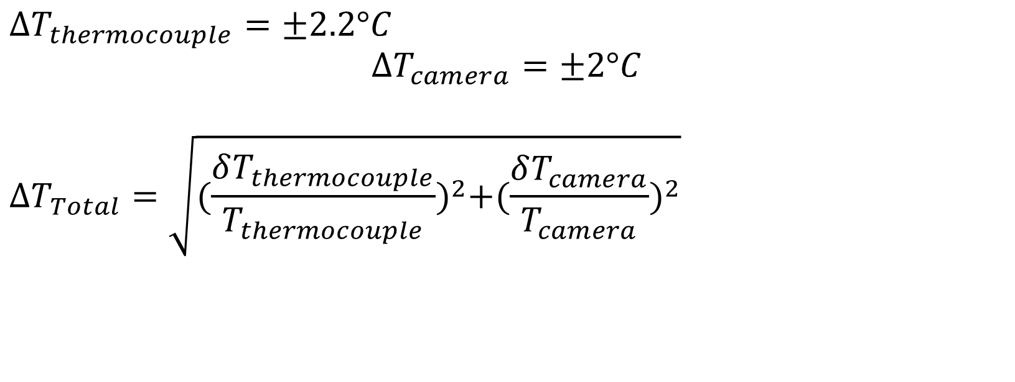
4. Insulation Temperature - Uncertainty
${ΔT}_{thermocouple}=±2.2°C$
$${ΔT}_{camera}=±2°C$$
$${ΔT}_{Total}=\sqrt{{(\frac{δT_{thermocouple}}{T_{thermocouple}})}^{2}+{(\frac{δT_{camera}}{T_{camera}})}^{2}}$$
Notes:
Tesla

Slide 19
5. Hydrogen Production
Objective: Determine the amount of hydrogen produced by electrolysis. (req 1.1.1)
Facilities: Vent hood, electrolysis to valve 1, pressure gauge, electrolysis thermocouple, and stopwatch.
Location: Stem 114
Success Criteria: The electrolysis produces at least 0.002 grams of hydrogen per minute.
Notes:
Dylan
PROCEDURE: Fill electrolysis with salt solution and ensure safe electrical connection. Turn on power supply to 10 amps and record the pressure change and temperature over time until the maximum pressure of 4 in-WC. Vent hydrogen into the vent hood and repeat the process at 15, 5, and 20 amps. Use the ideal gas law to determine the amount of hydrogen is produced over time at different amperages.

Slide 20
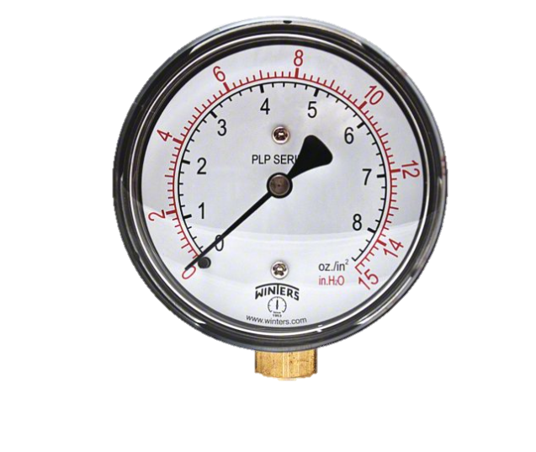
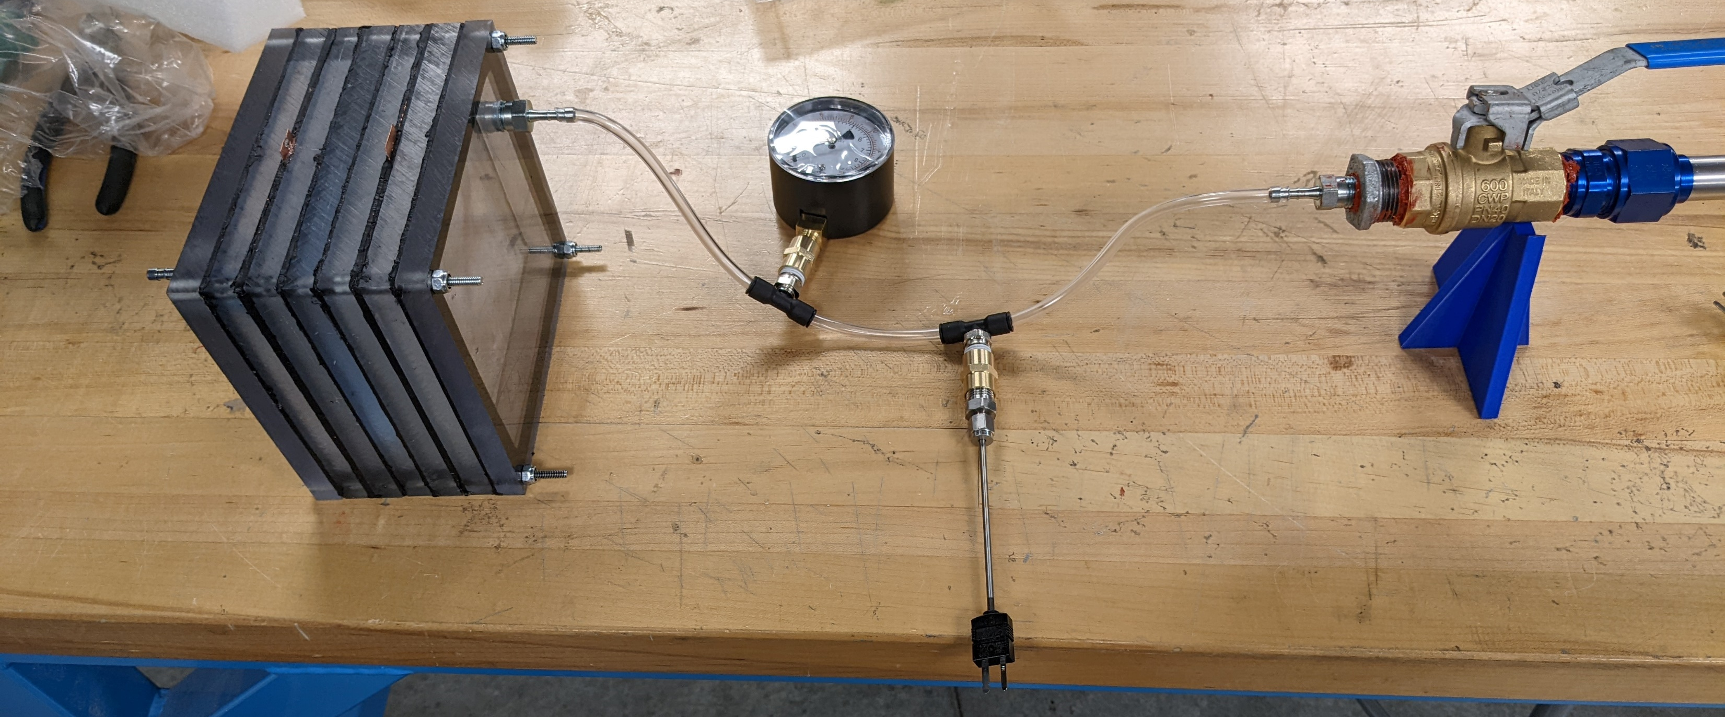
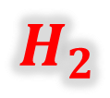
5. Hydrogen Production
Maximum: 4 in-WC
5, 10, 15, 20 Amps
$$H_{2}$$
Thermocouple
Close valve to heating system and run electrolysis until pressure reads 4 in-WC.
Record pressure and temperature over time at intervals of 20 seconds.
Notes:
Dylan

Slide 21
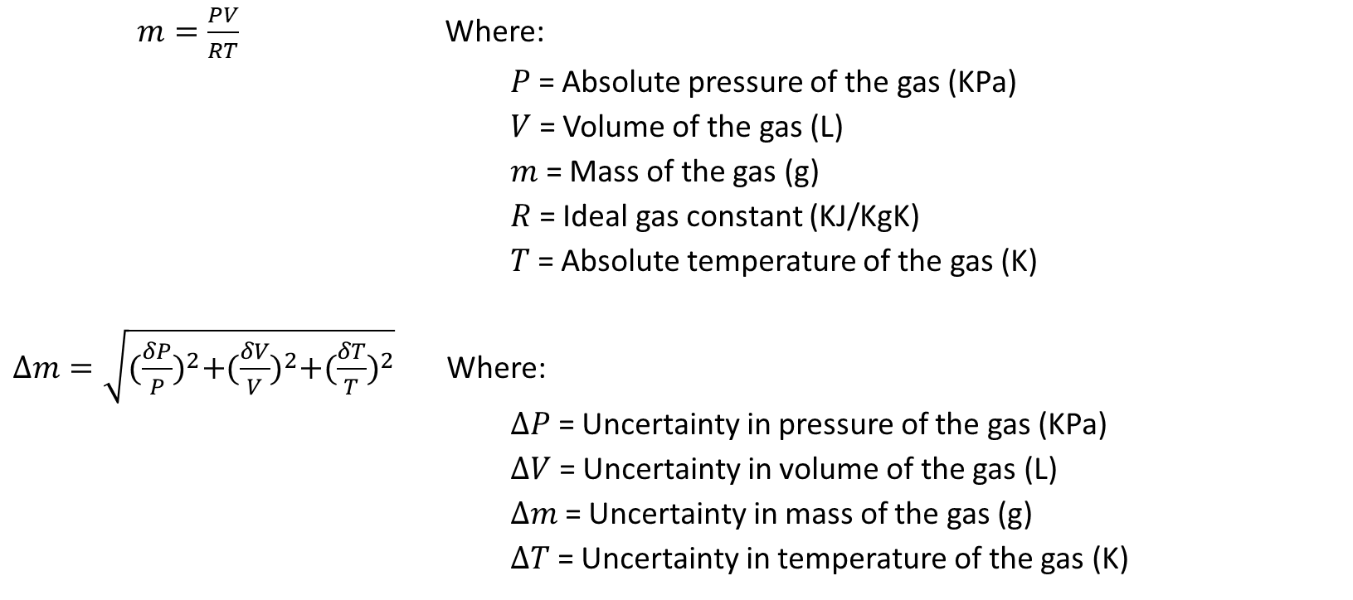
5. Hydrogen Production - Uncertainty
$m=\frac{PV}{RT}$ Where:
$P$ = Absolute pressure of the gas (KPa)
$V$ = Volume of the gas (L)
$m$ = Mass of the gas (g)
$R$ = Ideal gas constant (KJ/KgK)
$T$ = Absolute temperature of the gas (K)
$Δm=\sqrt{{(\frac{δP}{P})}^{2}+{(\frac{δV}{V})}^{2}+{(\frac{δT}{T})}^{2}}$ Where:
$ΔP$ = Uncertainty in pressure of the gas (KPa)
$ΔV$ = Uncertainty in volume of the gas (L)
$Δm$ = Uncertainty in mass of the gas (g)
$ΔT$ = Uncertainty in temperature of the gas (K)
Notes:
Thermocouple +- 2.2 C
Volume (math)
Scale uncertainty +- 0.0001

Slide 22
6. Material Storage Capacity
Objective: Determine the capacity of the material storage. (req 1.2)
Facilities: Vent hood, electrolysis to material storage system, material storage capsule, pressure gauge, scale
Location: Stem 114
Success Criteria: The mass of the capsule after filling is at least 0.02 grams heavier than its initial mass.
Notes:
Hannah
Procedure: The dry material capsule is weighed, then the mass is recorded. The capsule will be inserted into the system and a system flush will be done. After the flush, the valve to the fuel cell will be closed and the electrolysis will run until maximum pressure is reached. Then the valve will open again to vent the hydrogen out of the system and the capsule will be removed and weighed again. Using the capacity equation, the material storage wt % of hydrogen is found.

Slide 23
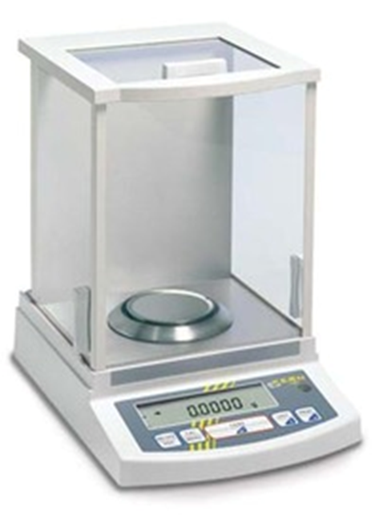
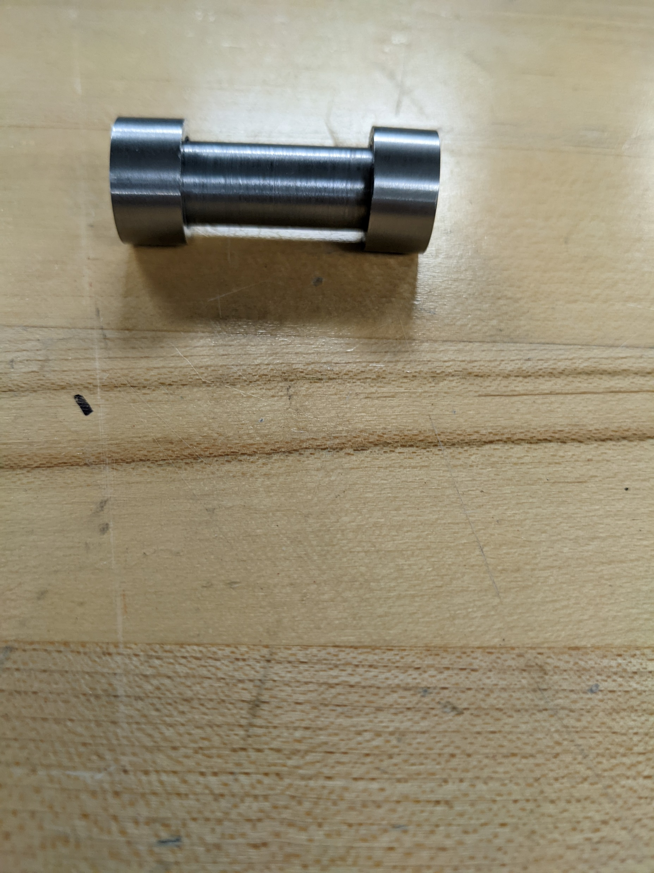
6. Material Storage Capacity
Weigh the material storage capsule.
Notes:
Hannah

Slide 24
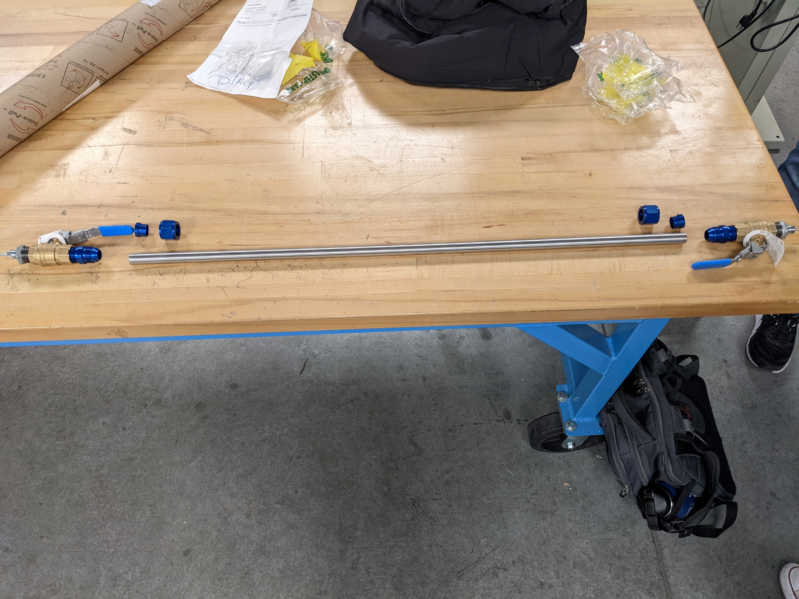
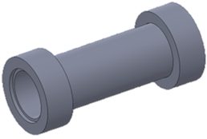
6. Material Storage Capacity
Insert capsule into the system in the marked heating zone.
Notes:
Hannah

Slide 25

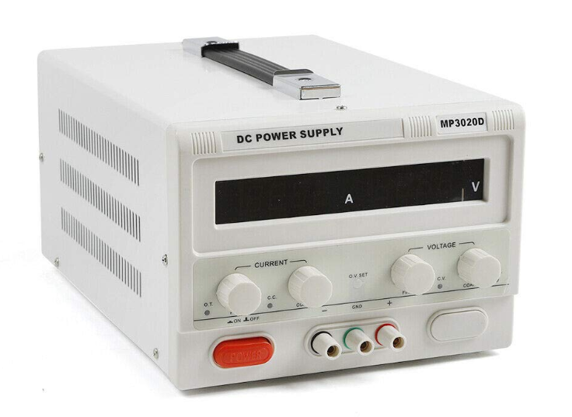
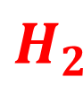
6. Material Storage Capacity
$$H_{2}$$
Run a flush of the system to remove excess air.
Notes:
Hannah

Slide 26
6. Material Storage Capacity
Maximum: 4 in-WC
Close the valve by the fuel cell and continue running electrolysis until pressure reaches 4 in-WC.
Notes:
Hannah

Slide 27


6. Material Storage Capacity - Uncertainty
Weigh the material storage capsule again to determine the mass of hydrogen stored.
$$m_{H_{2}Stored}=m_{final}−1$$
$$\%_{wtH_{2}}=\frac{m_{H_{2}Stored}}{m_{final}}$$
$$Δm=±0.0001 g$$
Requirement 1.2: The storage method must run the fuel cell for a minimum of 5 minutes.
Notes:
Hannah

Slide 28
7. Hydrogen Release
Objective: Determine how much hydrogen can be released by the material storage. (req 1.2)
Facilities: Vent hood, electrolysis to material storage system, material storage capsule, pressure gauge, scale.
Location: Stem 114
Success Criteria: The mass of the capsule after release is at least 0.02 grams less than the mass of the capsule after filling.
Notes:
Dylan
PROCEDURE: The material storage capsule is weighed and the mass is recorded. The capsule is reinserted into the system and aligned in the heating zone. Run a flush on the system and then initiate the extraction procedure. Record the temperature of the heating zone every 5 minutes until it reaches 300 C. Once the pressure gauge indicates an increase in pressure, record how long the fuel cell runs. Once the fuel cell stops running, turn off power supply and remove capsule to weigh again.

Slide 29
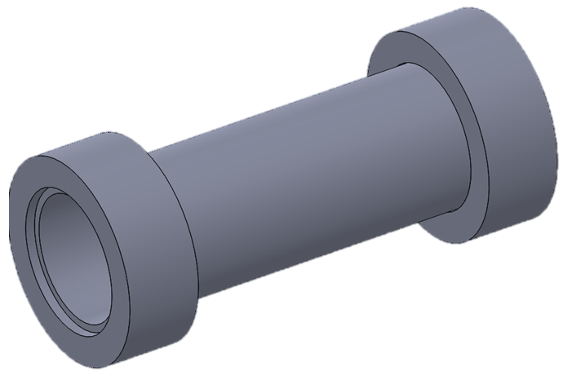
7. Hydrogen Release
Weigh the material storage capsule.
Notes:
Dylan

Slide 30
7. Hydrogen Release
Insert capsule into the system in the marked heating zone.
Notes:
Dylan

Slide 31
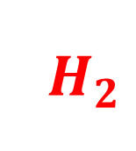
7. Hydrogen Release
$$H_{2}$$
Run a flush of the system to remove excess air.
Notes:
Dylan

Slide 32
7. Hydrogen Release
Valves Closed
Thermocouple
Close both valves and turn on power supply to heat capsule to 300°C.
Record temperature of heating zone every 5 minutes
Notes:
Dylan

Slide 33
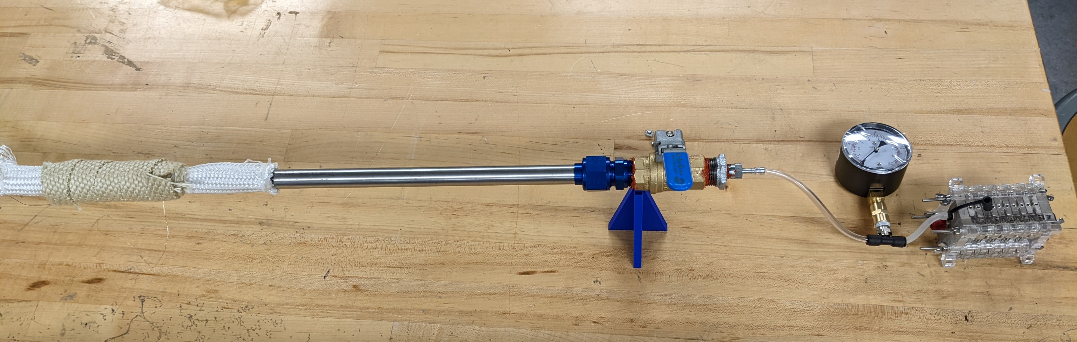
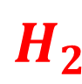
7. Hydrogen Release
300°C
$$H_{2}$$
Once the heating zone reaches 300°C, open the valve to the fuel cell and run until the fuel cell’s light turns off.
Notes:
Dylan

Slide 34


7. Hydrogen Release - Uncertainty
Weigh the material storage capsule again to determine the mass of hydrogen released.
$$m_{H_{2}Released}=m_{final}−m_{initial}$$
$$Δm=±0.0001 g$$
Requirement 1.2: The storage method must run the fuel cell for a minimum of 5 minutes.
Notes:
Dylan

Slide 35
8. Flow Storage
Objective: Determine if the material storage can load while hydrogen runs from the electrolysis to the fuel cell (req 1.2).
Facilities: Electrolysis to fuel cell configuration, scale, and stopwatch
Location: Stem 114
Success Criteria: If the capacity of the material storage is the same with the second valve open or closed.
Notes:
Grant
PROCEDURE: Weigh the material storage capsule and then put the capsule in the heating zone. Connect the system in the electrolysis to fuel cell configuration with both valves open. Turn on the electrolysis and run the fuel cell for 10 minutes. Turn off the electrolysis and remove capsule and weigh again. Record the difference and compare the results to the material capacity test.

Slide 36
8. Flow Storage
Weigh material storage capsule.
Notes:
Grant

Slide 37
8. Flow Storage
Insert capsule into heating zone.
Notes:
Grant

Slide 38

8. Flow Storage
$$H_{2}$$
Run a flush on system to remove excess air.
Notes:
Grant

Slide 39
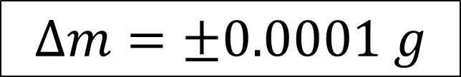
8. Flow Storage - Uncertainty
Compare the results of the two capacity tests to determine the best way to load the material.
Uncertainty of the scale
$$Δm=±0.0001 g$$
Notes:
Grant

Slide 40
Risk & Safety
Notes:
Grant

Slide 41
Risk Analysis
“There is no risk in this project.”
– Jonathan Adams, Ph.D. 12/7/2022
Notes:
Jacob

Slide 42
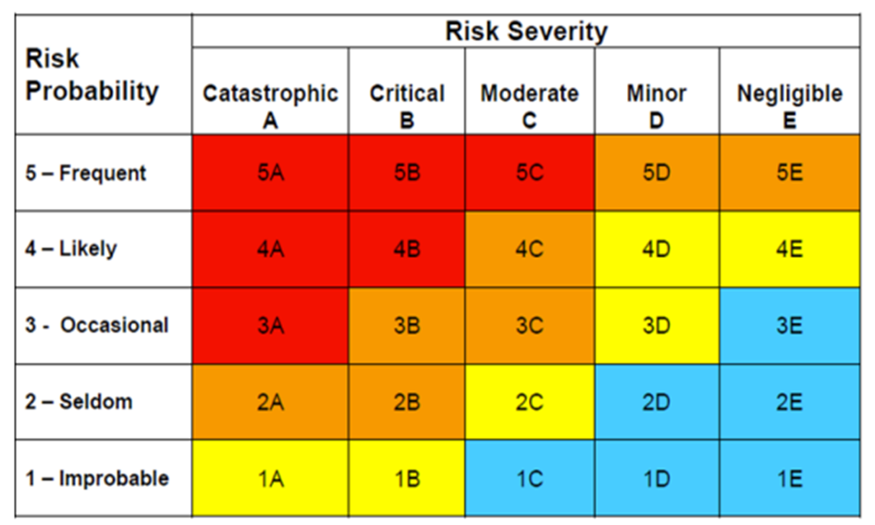
Risk Analysis
Notes:
Titan

Slide 43
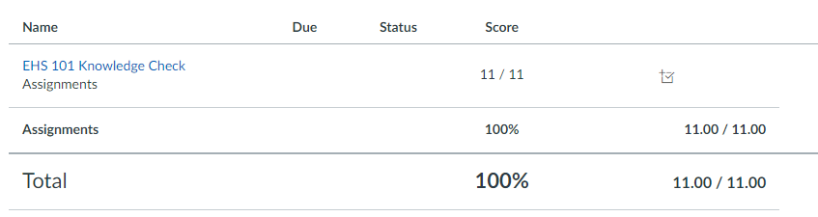
Safety
All team members have completed the EHS safety course
Our SOP for chemical usage is approved
No one will be allowed to touch any part of the system other than the insulated valve handles while there is power to any part of the system
STEM 114 is equipped with vent hood, eye wash station, and fire extinguisher
Notes:
Dylan

Slide 44
Timeline
April 2023
May 2023
TRR
Symposium
1
5
10
15
20
25
28
Fabrication
TRR Preparation
Testing
Final Report
Notes:
Dylan

Slide 45
Acknowledgements
Dr. Karl Heine
Dr. Johnathan Adams
Professor Andy Gerrick
Dr. Elliott Bryner
Dr. Tersea Eaton
AXFAB Staff
Notes:
Dylan

Slide 46
Questions?
?
?
?
Notes:
Dylan

Slide 47
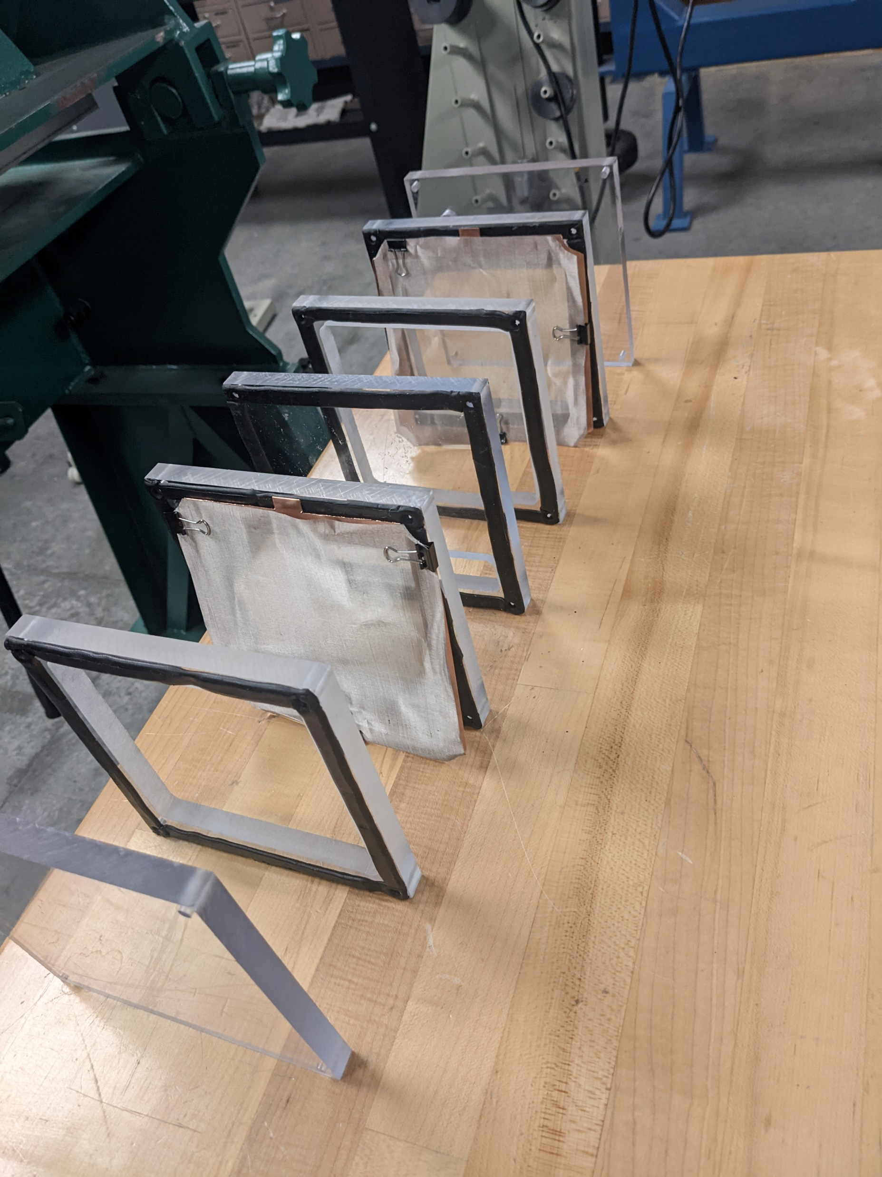
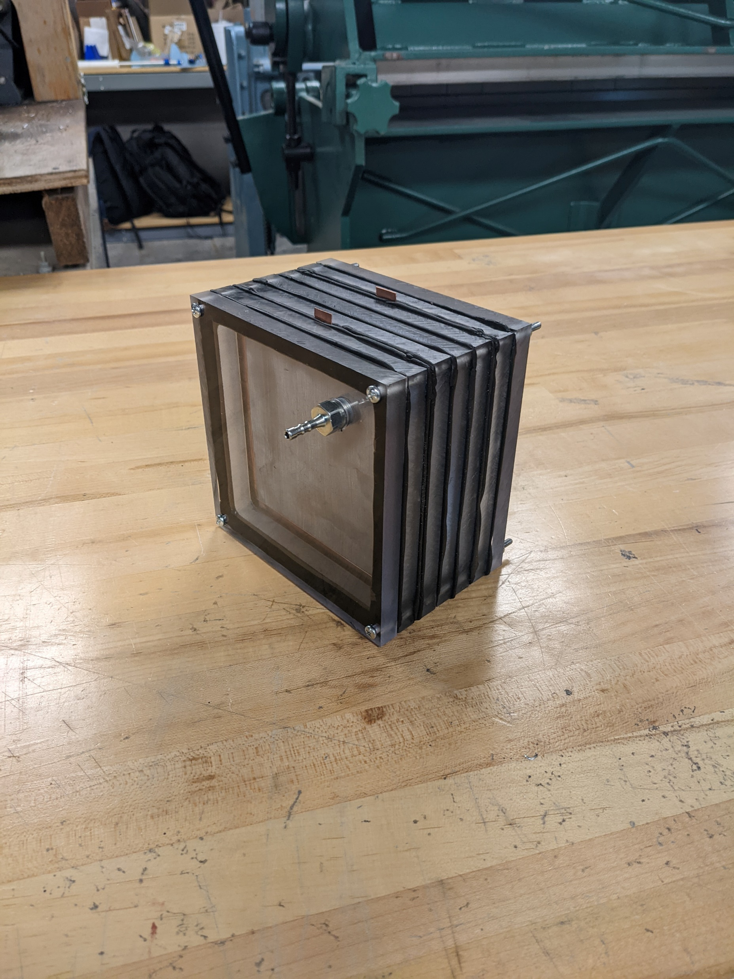
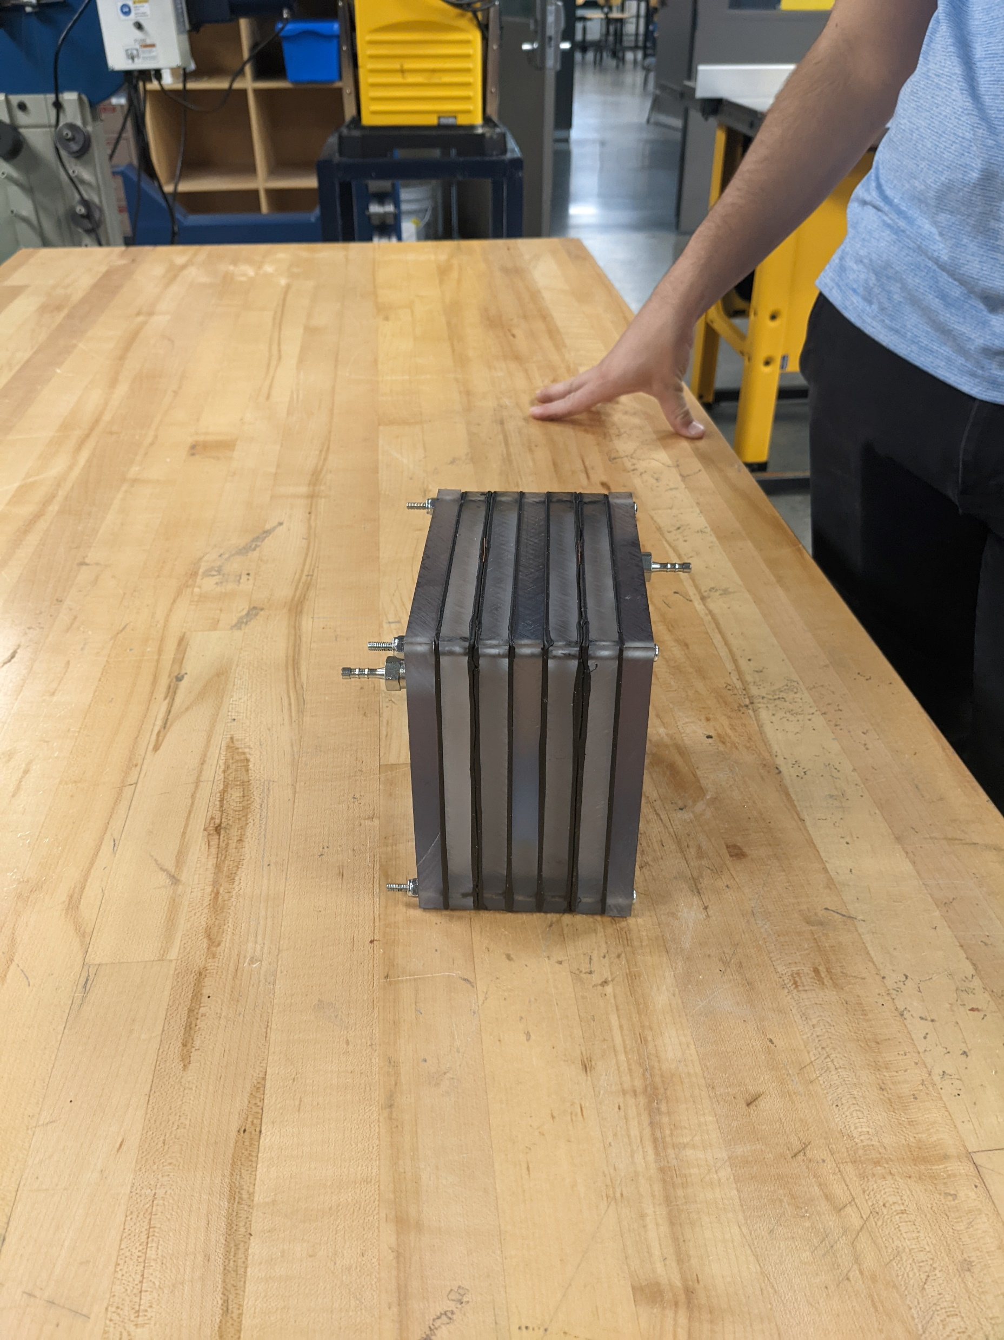
Electrolysis

Slide 48
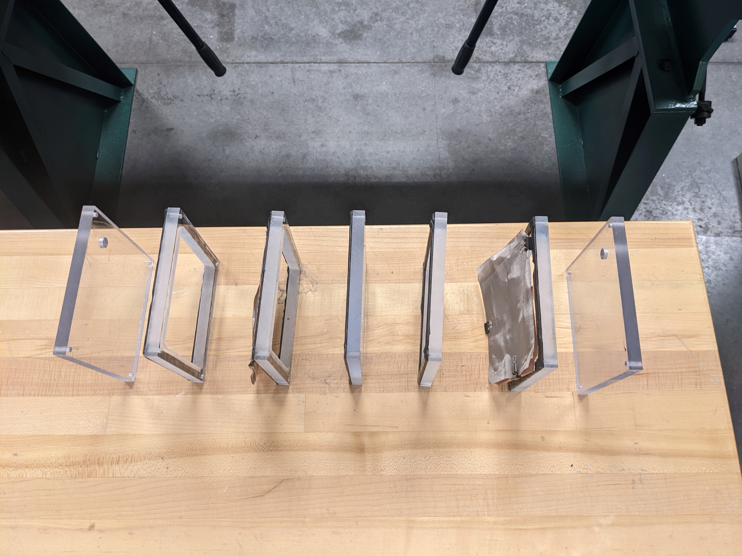
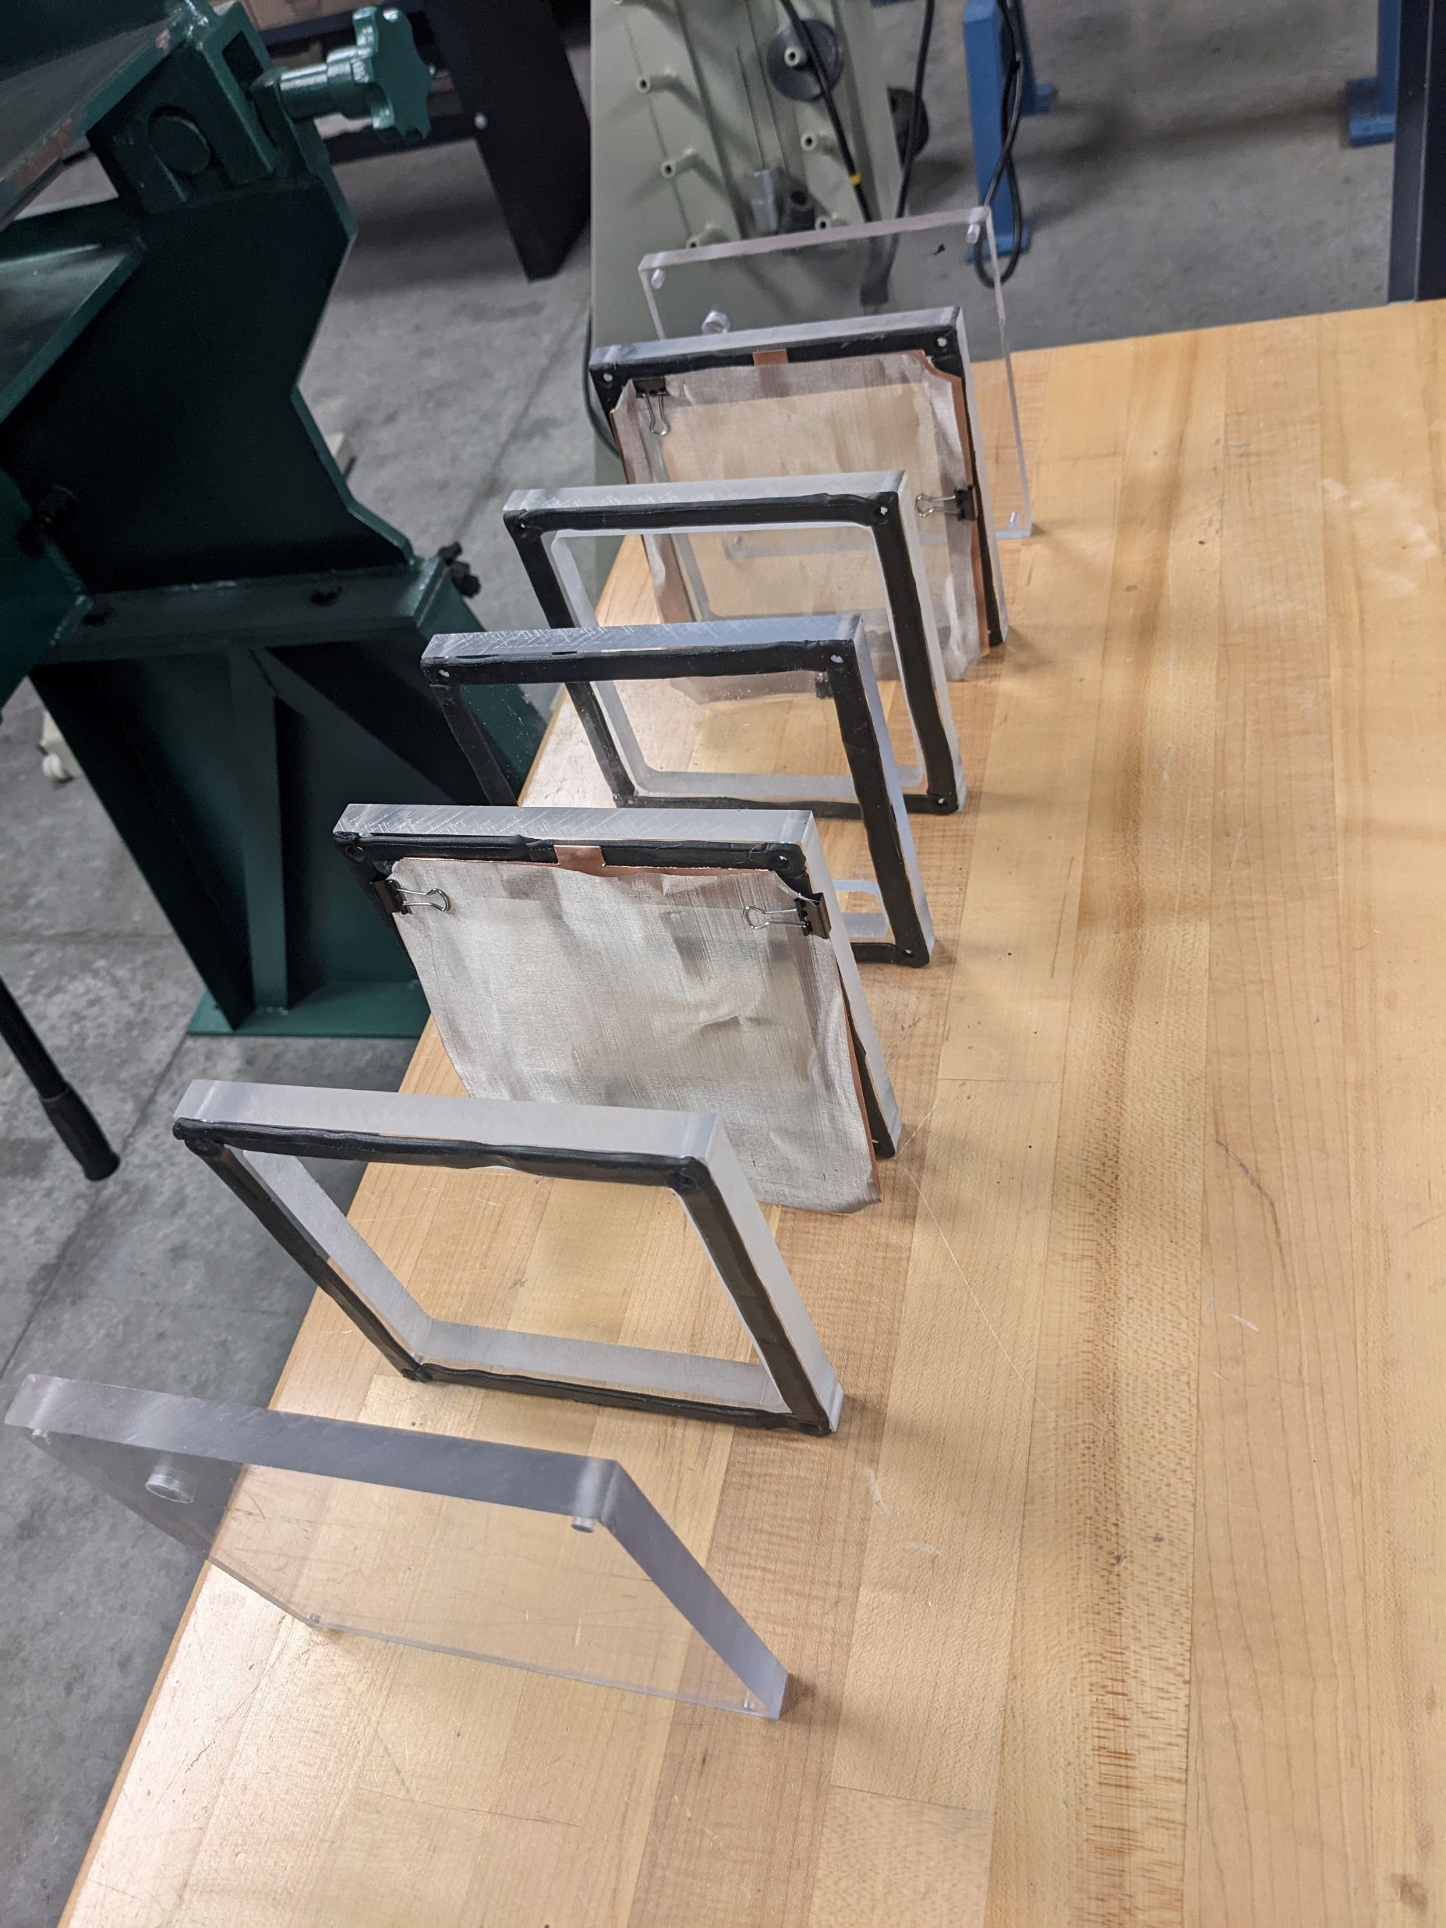
Electrolysis

Slide 49
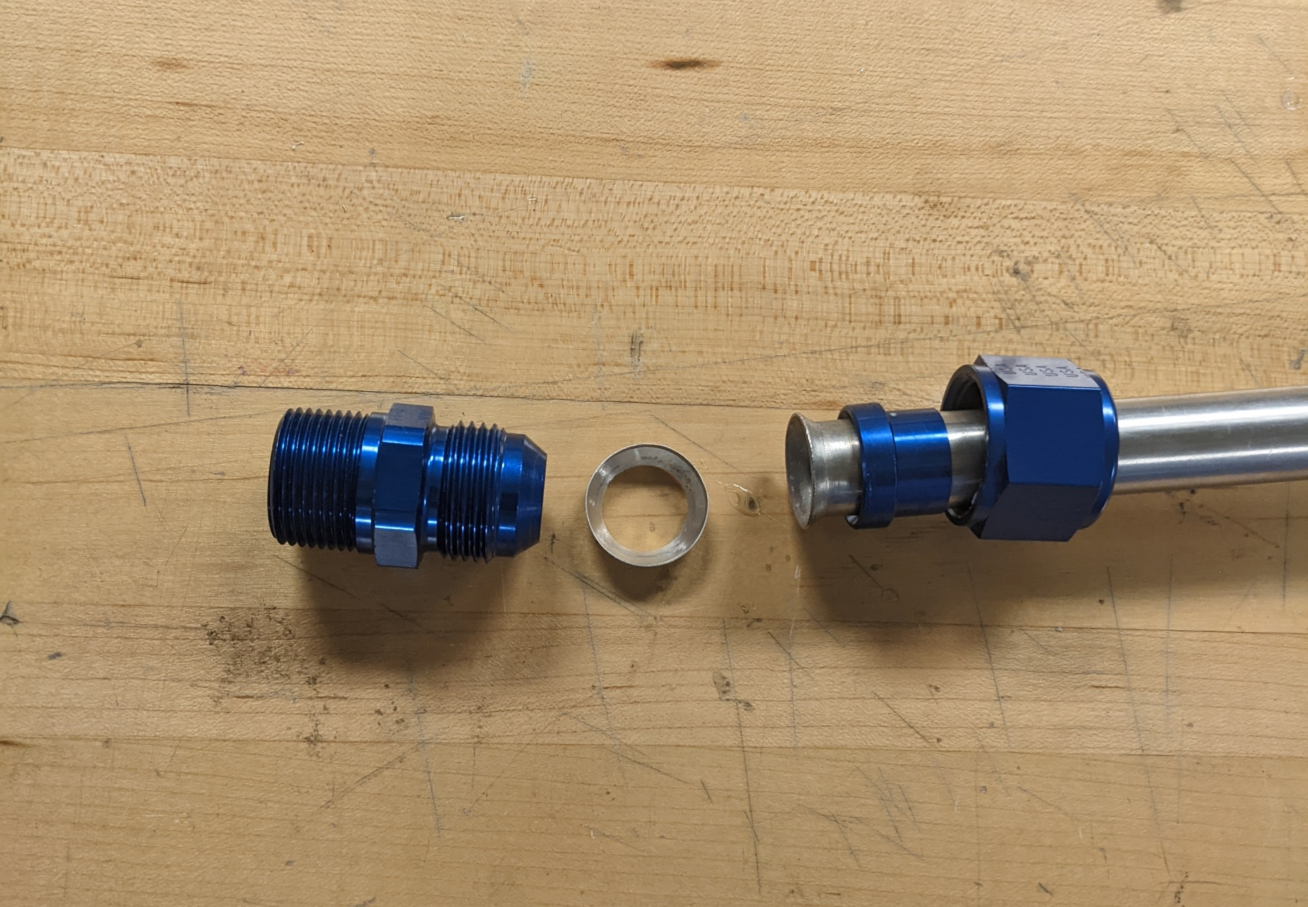
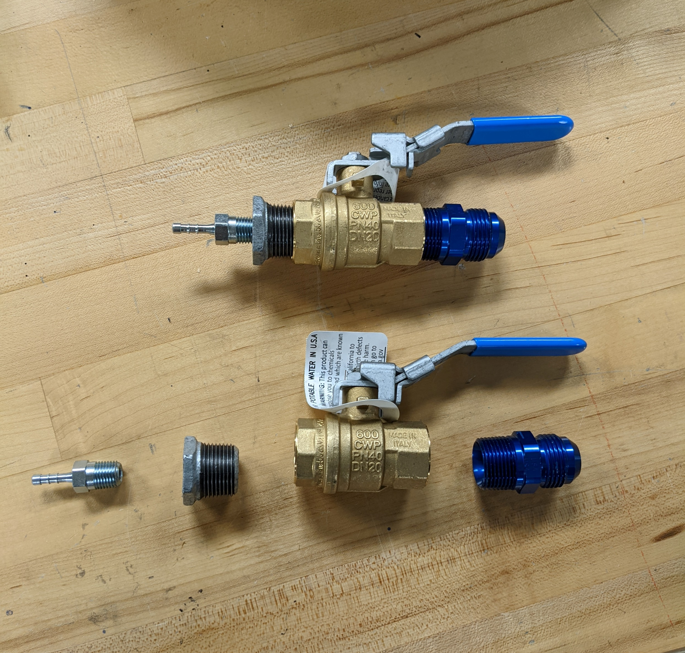
Pipe and Fittings

Slide 50


ME WHEN
CAPSTONE

